Slide 1

Trees
CISC 160
Data Structures
Brian Grey

Slide 2
What are we doing today?
Trees
Terminology and Definitions
Creating Nodes and Generic Trees
Binary Trees
General Structure
Recursion
Traversal Algorithms
Uses

Slide 3
What is a tree?
Definitions:
An acyclic graph
A non-linear, hierarchical data structure
This thing:
Entertainment
Podcasts
TV
Movies
RadioLab
M*A*S*H
Schitt’s Creek
Captain America
First Avenger
Winter Soldier

Slide 4
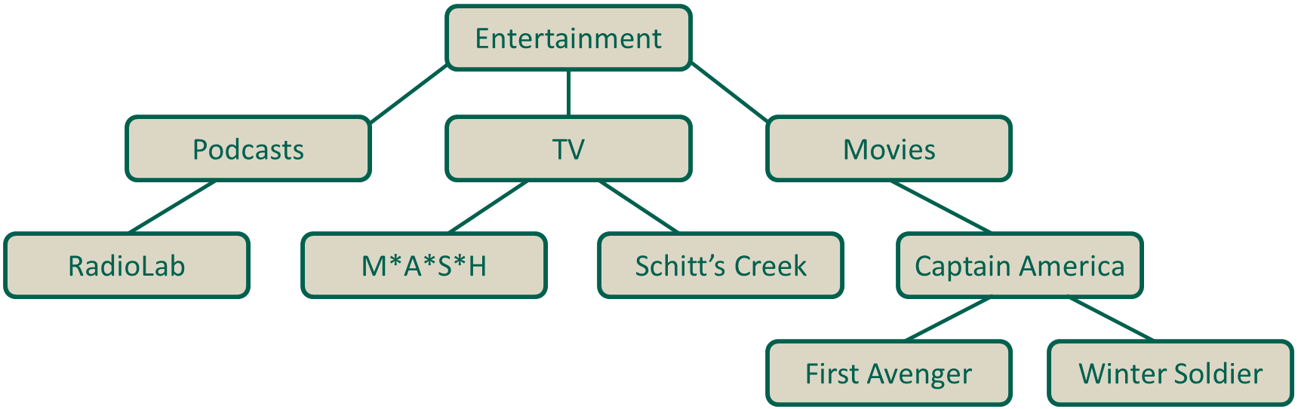
Definitions & Terminology
Definitions:
Node
An element in the tree
Edge
A connection between two nodes showing a parent/child relationship
Root
Node with no parents/Ancestor node of ALL other nodes
Leaf
Node with no children

Slide 5
Definitions & Terminology
Definitions:
Degree
The number of children a node has
Siblings
All nodes with the same parent node
Sub-tree
The tree created from a node and all of its descendants
Path
A sequence of nodes to get from one node to another

Slide 6
Definitions & Terminology
Definitions:
Level/Depth
How far into a tree a node is
How many edges you need to traverse to reach the node
Root is at level/depth of 0, its children level/depth of 1, etc.
Height
The number of nodes in the longest path from the root to a leaf
Multiple paths may fulfill this requirement

Slide 7
Tree Abstract Data Type
Given the above definitions, we could imagine creating a Tree object with a pre-defined interface
Potential methods:
root()
len()
is_empty()
All other behaviors would require some sort of ordering to be enforced or otherwise established
Nothing wrong with this, but makes the implementations more specialized to the given situation
is_leaf(node)
is_root(node)
contains(element)

Slide 8
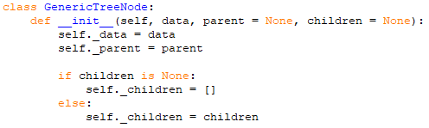
What is a Tree Node?
Similar to a node in a linked list
Contains data
Contains links to other nodes it is connect to
Child node(s)
Parent node?
If we were to implement it in Python, we could make a basic one:
Many algorithms/applications work best with a specific tree type

Slide 9
Binary Trees
Tree where each node contains no more than two children
Children are labeled left and right child
Complete
Every level is completely filled except for (possibly) the last
If the last level is not completely filled, it is filled from left to right
Full/Proper Binary Tree
Node has 0 or 2 children (Every parent has 2 children

Slide 10
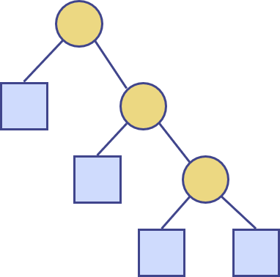
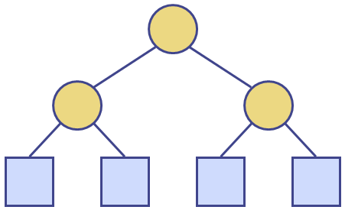

Properties of Full/Proper Binary Trees
Given $n$ nodes, $e$ leaf nodes, $i$ internal/non-leaf nodes, and a height of $h$, full binary trees have the following properties:
$e=i+1$
$n=2e−1$
$h≤i$
$h≤\frac{n−1}{2}$
$e≤2^{h}$
$h≥\log_{2}{e}$
$h≥(\log_{2}{(n+1))−1}$

Slide 11
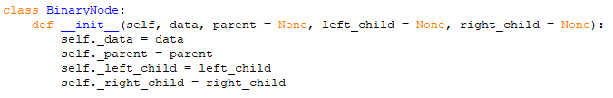
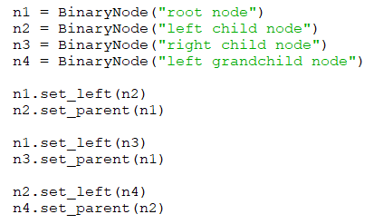
Building Binary Trees
First, we can alter our basic, generic tree node:
Then we can construct nodes and assemble our tree:

Slide 12
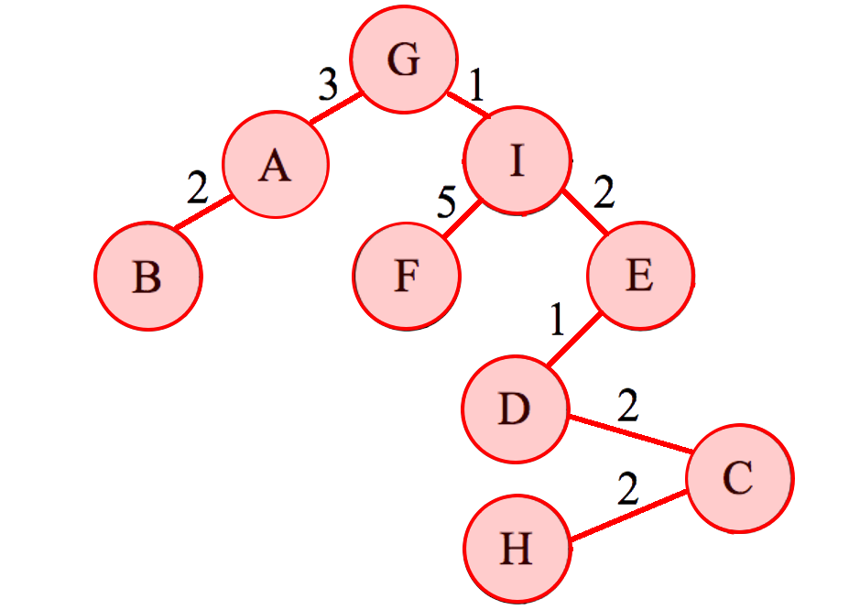
Breadth-First Traversal/Search
Iterating over a list is easy. Trees are trickier.
Breadth-first traversal examines all nodes at a level before moving to the next level using the algorithm:
Add the root to a FIFO queue
While the desired element has not been found and there are still elements in the queue
Dequeue a node
If the node doesn’t have the desired element
Add the current node’s children to the queue

Slide 13

Breadth-First Traversal/Search Performance
Analysis
Efficiency:
$O(\left|E\right|+\left|V\right|)$
Remember $O(\left|E\right|)$ can be between $O(1)$ and $O\left({\left|V\right|}^{2}\right)$
Memory intensive
Weak for deep nodes on wide trees

Slide 14
Depth-First Traversal/Search
Depth-first traversal considers a path all the way to a leaf node before considering a new path using the algorithm:
[Add the root to the list of visited nodes]
For all children of the current node
PRE[If child hasn’t been visited,] recursively visit the left children
IN[If child hasn’t been visited,] recursively visit the right children
POST
Wait…recursively?
Notes:
BFS = 1,2,3,4,5,6,7
Pre

Slide 15
Recursion
What is it?
A function which is defined in the terms of itself
A function which calls itself
Also can be applied to a “fractal” structure
Structure where sub-aspects of the structure can be considered complete versions in their own right
Upside is that the recursive methodology is very helpful and useful when using a recursive structure

Slide 16
Recursion
How do we define a recursive function?
Two elements, determined by an if statement:
Base case
The most basic/simple/elemental condition for the function
Recursive case
Case where the function calls itself
The recursive call must move towards the base state
Functions can sometimes have multiple base or recursive cases
Let’s do an example!

Slide 17
Recursion
Define a recursive function to calculate factorial
def fact(x):
#Base case
if x == 0:
return 1
#Recursive case
else:
return x * fact(x – 1)

Slide 18
Recursion
Define a recursive function to calculate factorial
Can be done in the main function or a recursive helper function
def fact(x):
return fact_helper(x, 1)
def fact_helper(x, n)
#Base case
if x == 0:
return n
#Recursive case
else:
return fact(x – 1, x*n)

Slide 19
Recursion
Uses for recursion?
Any problem that can be solved with iteration can also be solved with recursion
Benefits & Drawbacks
…No real structural benefits
Although some problems are more naturally inclined towards one approach or another
The only downside to recursion is that it is more computationally intensive due to all the method calls
Best used when you can divide the data significantly with each recursive call

Slide 20
Depth-First Traversal/Search
Depth-first traversal considers a path all the way to a leaf node before considering a new path using the algorithm:
[Add the root to the list of visited nodes]
For all children of the current node
[If child hasn’t been visited,] recursively visit the left children
[If child hasn’t been visited,] recursively visit the right children
When is the current node checked?
Depends on the type of DFS

Slide 21
Depth-First Traversal/Search
Pre-order DFS
Check current node before visiting any children
“The first time you see it” in a binary tree
In-order DFS
Check current node after visiting left but before right children
“The second time you see it” in a binary tree
Post-order DFS
Check current node after visiting all children
“The third time you see it” in a binary tree
Portioning rules for “left vs. right” children affect non-binary trees

Slide 22

Depth-First Traversal/Search Performance
Analysis
Efficiency:
$O(\left|E\right|+\left|V\right|)$
Memory efficient
Weak for wide nodes on deep trees

Slide 23
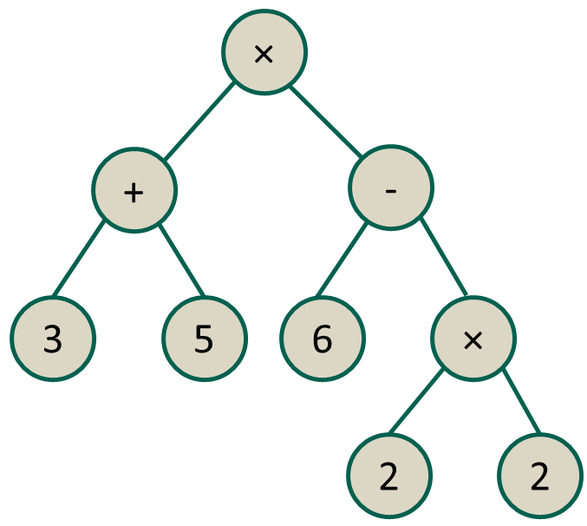
Mathematical Notation
Trees can be generated to express mathematical equations
The method by which you traverse the tree results in different formats for the equation. Given this tree:
Pre-fix notation: (× (+ 3 5) (- 6 (× 2 2)))
In-fix notation: ((3 + 5) × (6 - (2 × 2)))
Post-fix notation: ((3 5 +) (6 (2 2 ×) -) ×)
Post-fix is sometimes called Reverse
Polish Notation or RPN
(Invented in the 1920s by the Polish
mathematician Jan Lucasiewicz)

Slide 24
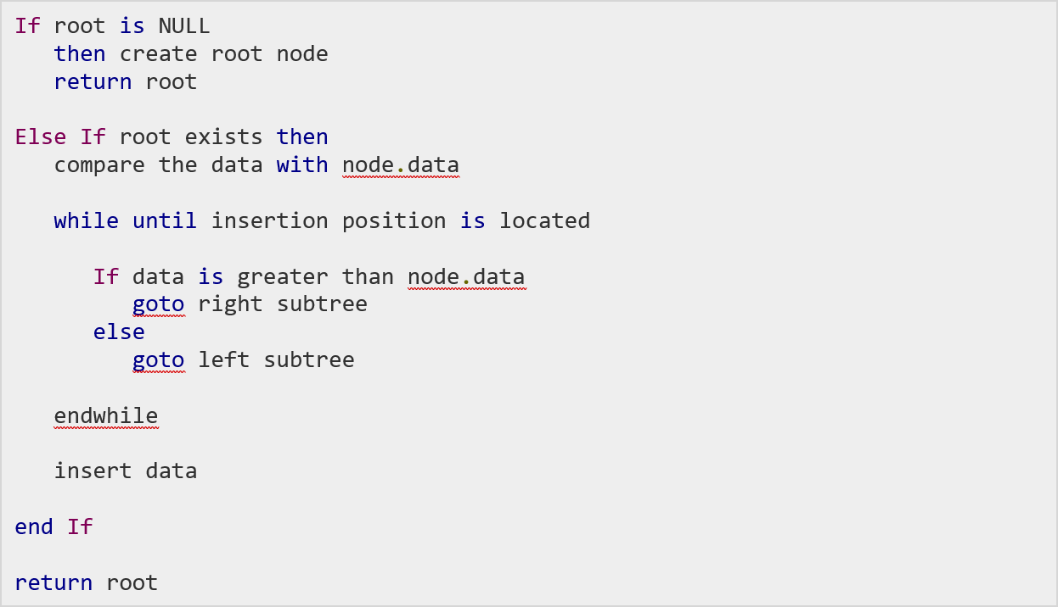
Lab 04
Binary tree which is created using a specific process:

Slide 25
Lab 04
So this means:
We need a binary node
(Inheriting from DNode)
We need to be able to create a binary tree with that methodology
A way to check that the tree has been correctly created
(The hidden in-order print method)
A way to find elements in the tree:
Iterative path
Recursive path

Slide 26
Questions?

